Slide 1

Intelligent Solution for Visually Impaired

Slide 2

Group Members
Agha Saad Fraz
Areesha Tariq
Hadiqa Alamdar Bukhari
Advisor:
Dr. Muhammad Ali Tahir
Co-Advisor:
Dr. Asif Ali
2 of 26

Slide 3
Mandatory Slide
FYP Report reviewed by Advisor - Yes
FYP Report uploaded on PMS - Yes
FYP Demo reviewed by Advisor - Yes
FYP Demo uploaded on PMS - Yes
Course feedback of all courses submitted on CMS - Yes

Slide 4


Market Size
285 M
WORLDWIDE
2 M
Pakistanis

Slide 5

Problem Statement
Lack of assistive technologies
Economic barriers
The available technology is too expensive

Slide 6

Proposed Solution
Make a mobile application
Ease of travelling
Text reading
Maintain a low building cost
Assistive Technology

Slide 7
Literature Review
BeSpecular with sighted volunteers
Aipoly vision is an object and colour recognizer
MD_evReader App with text reading functionality.
iDentifi with object detection and text reading
Seeing AI also with object detection and text reading

Slide 8
Initial Approach
Raspberry Pi
APR33A3
Audio Playback and Record kit
Webcam
headphones
Raspberry Pi
YOLO and OpenCV for Object detection
Tesseract and OpenCV for OCR

Slide 9
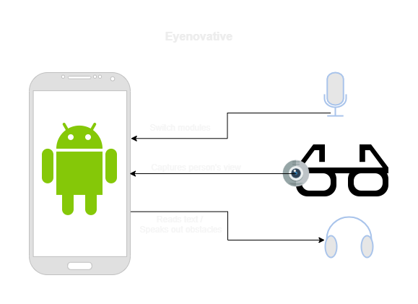
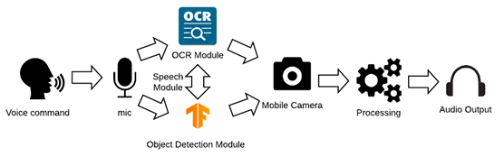
Current Approach

Slide 10
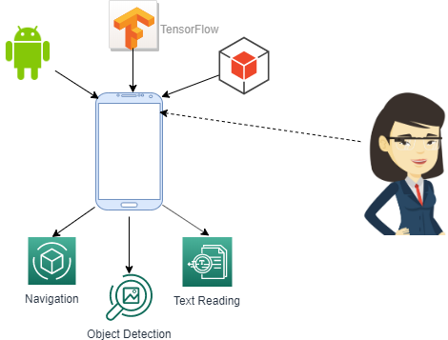
Features
Object Detection
Optical Character Recognition
Speech Recognition
Text to Speech

Slide 11
Object Detection
Tensorflow Lite Object detection model
Model: COCO SSD MobileNet
Real-time detection
COCO Dataset
Recognises 80 different classes of objects.
Labelled class objects

Slide 12
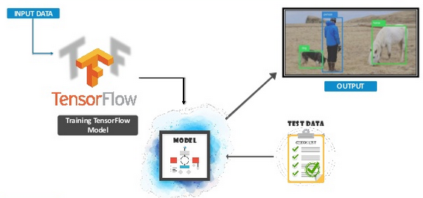
Object Detection

Slide 13
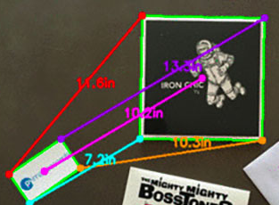
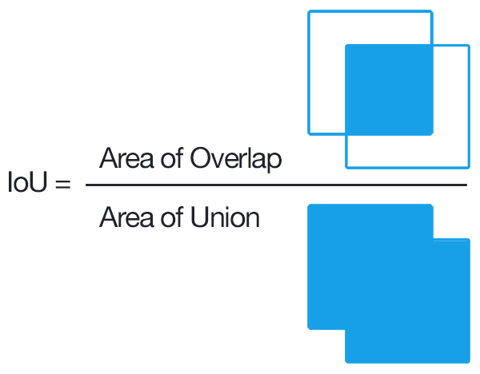
Accuracy Improvement
Euclidean distance
Thresholding
Mean average precision
Intersection over union

Slide 14
Optical Character Recognition
Mobile Vision Text API for the detection and recognition of text
Optimized for dense text and documents
Real-time text detection
Google text to speech API
OCR Accuracy: 83.5%

Slide 15
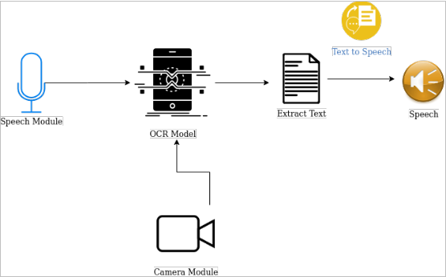
Optical Character Recognition

Slide 16
Speech Module
Easy to use hands free interface
Switching between modules
Initially used Android SpeechRecognizer class
Continuous listening
Hotword detection

Slide 17
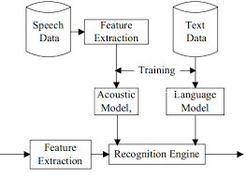
Speech Module
PocketSphinx speech recognition engine
Custom dictionary

Slide 18
Speech Module
87% accuracy achieved
Module tested on dataset from Project Shkoota, Wikimedia Commons and Forvo

Slide 19
Future Improvements
Making a wearable product.
iOS compatible
Handwriting recognition
Voice recognition for different languages
OCR for different languages
Increasing the number of objects for object detection
Improving accuracy

Slide 20
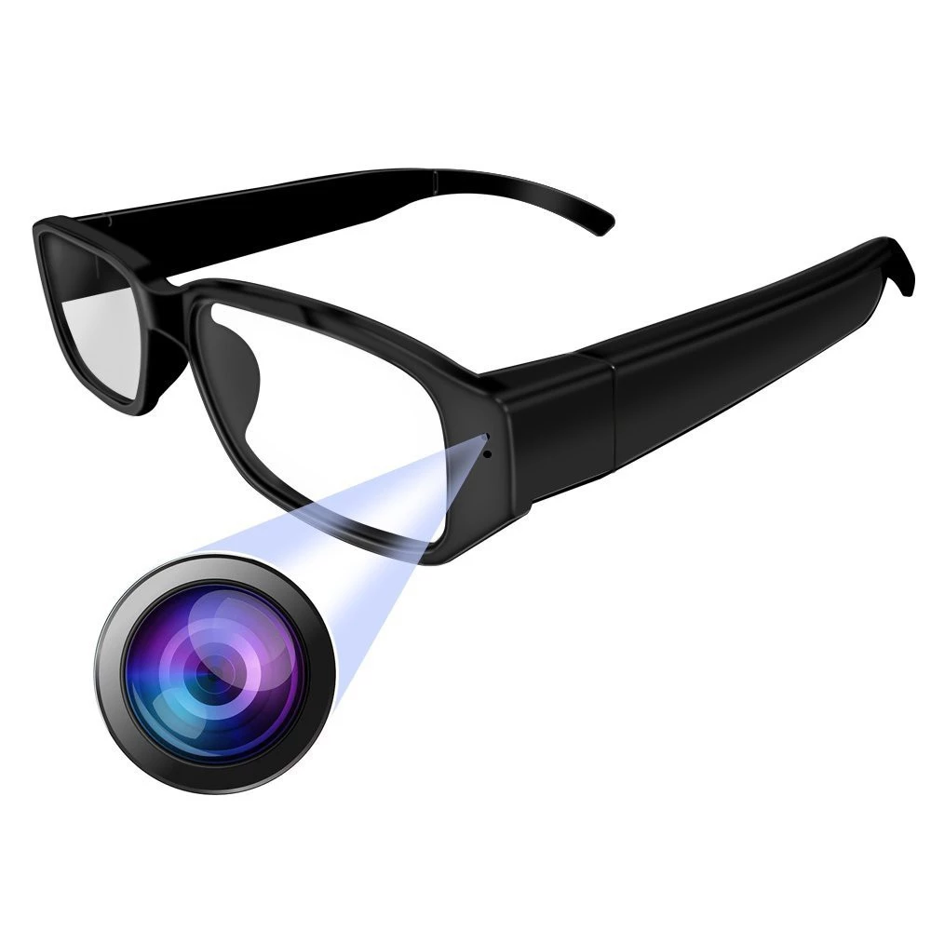
Future Improvements
Product
Price
Rs 3,000/unit
Total market: 20.78 m
Target Market: 2%
1.2 m profit
PRODUCT
PRICE
Place
Promotion
PLACE
NGOs
Opticians
Crowd funding campaigns
Medical Practitioners
Hospitals
Clinics
NGOs
PROMOTION

Slide 21
Timeline
Oct - Nov
February
May - June
-Object Detection
-Speech Recognition
-Camera Module
-Accuracy
Improvement
June-August
Dec - Jan
March - April
-Research
-Idea Refinement
-Initial Approach
-OCR Module
-Integration of Modules
- Change of Scope
- Switching between
modules

Slide 22
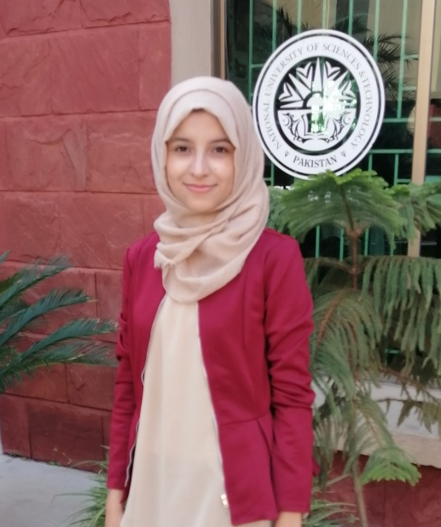
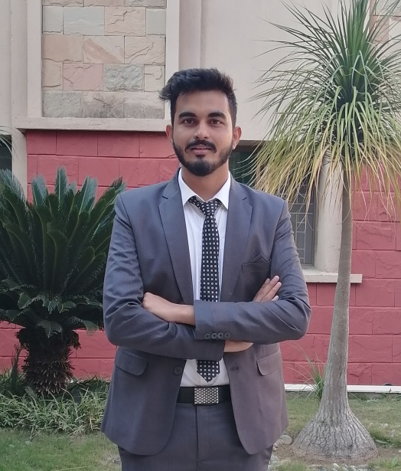
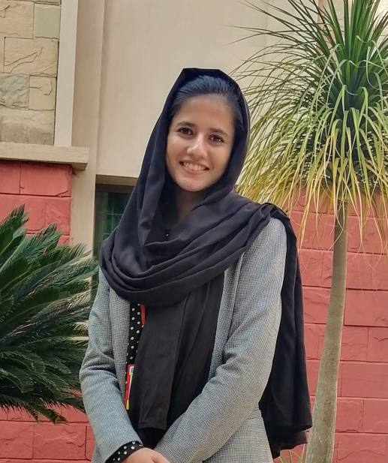
Work Division
Areesha Tariq
OCR Module:
Tesseract
MaryTTS
Text Recognition API
Text to Speech API
Agha Saad Fraz
Object Detection Module:
YOLO
TensorFlow Lite
Text to Speech API
Hardware Integration
Hadiqa Alamdar Bukhari
Speech Module:
Pocket Sphinx
Voice Commands
Hotwords
Modules’ Integration

Slide 23
References
[1] Aipoly.com, V7 AiPoly. [Online]. Available: https://www.aipoly.com/. [Accessed: 10- Jun- 2020].
[2] BeSpecular, BeSpecular. [Online]. Available: https://www.bespecular.com/. [Accessed: 10- Jun- 2020].
[3] Identifi, Identifi - Connect What Matters. [Online]. Available: https://identifi.net/. [Accessed: 10- Jun- 2020].
[4] Microsoft.com, Seeing AI App from Microsoft [Online]. Available: https://www.microsoft.com/en-us/ai/seeing-ai. [Accessed: 10- Jun- 2020].
[5] Who.int [Online]. Available: https://www.who.int/blindness/GLOBALDATAFINALforweb.pdf?ua. [Accessed: 07- Jun- 2020].

Slide 24
ONTO THE DEMO

Slide 25

Demo

Slide 26
THANK YOU!

